Slide 1
Unit 6
Menu Navigation and Webpage Protection

Slide 2
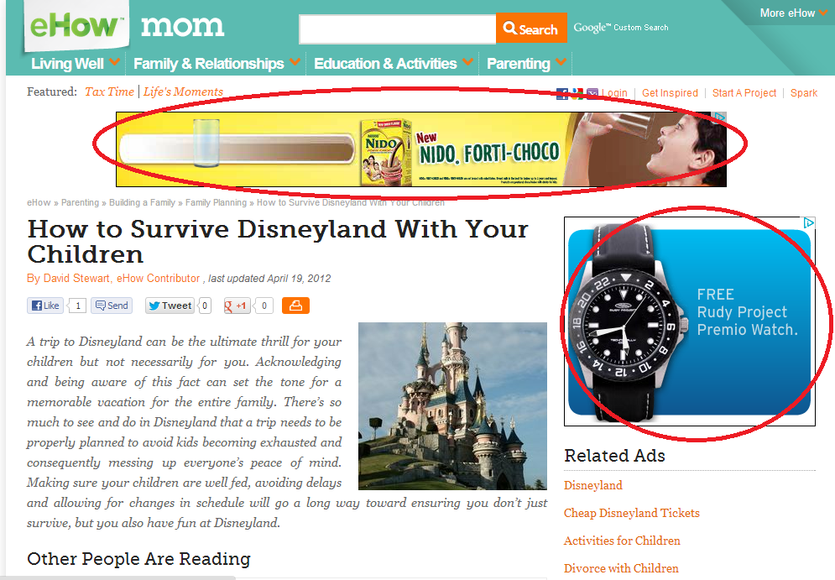
Banner

Slide 3
Banner
Displaying banners ads is a common practice for showing advertisements on web pages to the visitors.
Banners ads are normally created using standard graphic tools such as Photoshop, Paintbrush Pro, and other software.
Banner ads can be static or animated. Animated images are animated GIF files or flash movies. Flash movies are created using Macromedia Flash
You can create some animated effect using JavaScript, like rotating static banner ads at a certain time interval.

Slide 4
Creating Banner
Rotating banners ads comprises several banner images that constantly rotate on a webpage at a fix time interval.
You can create these banner images using standard graphics tools.
Banner images and name them as banner1.jpg, banner2.jpg, banner3.jpg

Slide 5
The JavaScript starts by declaring an array to store the banner images using the new Array keywords, as follows:
MyBanners=new Array(‘banner1.jpg’,’banner2.jpg’,’banner3.jpg’)
Each element in the array is assigned with an index, starting from 0.
To track the index of the current banner, we can assign the index to a variable.
Here we use the variable banner and initialize it with a value 0 to load the first banner image.

Slide 6
Next, we create a function ShowBanners which will display all the banner images at fix interval.
This can be achieved by incrementing the index values using the statement banner++ and when the index value is equal to the total number of elements in the array(denoted by MyBanners.length), the index value is set back to 0, which is the index of the first banner.
banner++; if (banner==MyBanners.length) { banner=0}

Slide 7
The process is repeated at a fix time interval using the setTimeout ( ) function.
The setTimeout ( ) function comprises two arguments, the first is the function to be activated, i.e the ShowBanners ( ) function and the second one is the duration measured in milliseconds
The final part of the JavaScript is to call out the ShowBanners ( ) function using the onload method

Slide 8
<html> <head>
<script language="Javascript">
MyBanners=new Array('banner1.jpg','banner2.jpg','banner3.jpg') ;
banner=0;
function ShowBanners() {
if (document.images) { // check if any img tag is there in the html
banner++;
if (banner==MyBanners.length) { banner=0;} document.ChangeBanner.src=MyBanners[banner]; setTimeout("ShowBanners()",5000)
}} </script>
<body onload="ShowBanners()">
<center>
<img src="banner1.jpg" width="900" height="120" name="ChangeBanner"/> </center>
</body>
</html>

Slide 9
Linking Banner to URL
Creating rotating banner images will provide the visitor to your webpage with some basic information.
However, if you want the visitor to get more information by clicking on the banner images, you need to create rotating banner ads that contain URL links.
The script is basically the same as the previous one but we need to add another array that comprises the links,

Slide 10
MyBannerLinks=new Array('URL1','URL2','URL3/')
You need to make sure that the arrangement of the links is in corresponding order with the banner images in the first array.
Next, we create the ShowLinks function to link the current banner image to the relevant URL and
then assign the URL to the href attribute of the anchor tag.
To load the banner images with URL links, we insert an anchor tag within the <body></body> section before the <img> tag that displays the current banner image.
The anchor tag’s attribute href is used to call the ShowLinks( ) function when the visitor clicks on the banner.

Slide 11
MyBanner = new Array('banner1.jpg','banner2.jpg','banner3.jpg');
MyBannerLinks=new Array(‘https://www.google.com',‘https://www.w3schools.com/’,‘https://www.wordstream.com/');
banner = 0;
function ShowLinks(){ document.location.href=MyBannerLinks[banner] }

Slide 12
<body onload="ShowBanners()">
<center>
<a href="javascript: ShowLinks()">
<img src="banner1.jpg" width="900" height="120" name="ChangeBanner"/>
</a>
</center> </body>

Slide 13

Creating SlideShow in Javascript
The JavaScript code for the slideshow is almost similar to the JavaScript code of the rotating banners but it gives control to the user to choose the banner ads he or she wants to see by clicking on the forward and backward buttons.

Slide 14
Create an array with images in Slideshow
MySlides=new Array(‘banner1.jpg’,’banner2.jpg’,’banner3.jpg’,’banner4.jpg’)
We use the variable Slide to indicate the index of the above array, where 0 represents the index of the first slide, 1 represents the index of the second slide and so on. We also created the function ShowSlides(SlideNumber) with the argument SlideNumber
To call this function, we created two buttons within the body tag, the Forward button, and the Back button. Clicking the Forward will pass the value of 1 to the argument SlideNumber and clicking the Back button will pass the value of -1 to the argument SlideNumber.

Slide 15
Using the statement:
Index = index +SlideNumber.
We can then load the next banner image or the previous banner image.
if (index >MySlides.length-1){ index=0
if (index < 0) { index = MySlides.length-1
The following Statement is to display the current image by referencing the name of the <img> tag.
document.img1.src=MySlides[index]

Slide 16
<head> <script language=”Javascript”> MySlides=new Array(‘banner1.jpg’,’banner2.jpg’,’banner3.jpg’,’banner4.jpg’) index=0 function ShowSlides(SlideNumber){
{ index=index+SlideNumber if (index>MySlides.length-1){ index=0 } if (index<0) { index=MySlides.length-1 } document.img1.src=MySlides[index] } } </script> </head>

Slide 17
<body> <P align=”center”>
<img src=”banner1.jpg” name=”img1” width=”900″ height=”120″ />
<p> <center> <table border=0> <tr> <td align=center> <input type=”button” value=”Back” onclick=”ShowSlides(-1)”> <input type=”button” value=”Forward” onclick=”ShowSlides(1)”>
</td> </tr> </table> </center> </body>

Slide 18
Creating Pulldown menu
Menu Bar is a graphical user interface control that serves as a navigation header for your web application or site.

Slide 19
<html>
<head>
<script>
function Displaypage(c){
page = c.options[c.selectedIndex].value
if(page != "“) {
window.location = page
}}
</script></head>
<body onload="document.Form1.MenuChoice.selectedIndex=0">
<form name="Form1">
<select name="MenuChoice" onchange="Displaypage(this)">
<option>Products</option>
<option value="computer.html">computers</option>
<option value="monitors.html">monitors</option>
</select></form></body></html>

Slide 20
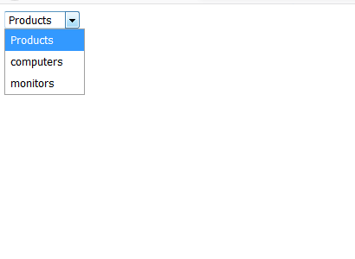

Slide 21
Dynamically Changing Menu
Making options listed context sensitive by changing menu dynamically.
<body onload="document.Form1.DeptList.selectedIndex=0">
<form name="Form1">
<select name="DeptList" onchange="GetEmp(this)">
<option value="0">Department</option>
<option value="1">Sales</option>
<option value="2">Marketing</option>
</select>
<select name="Employees">
<option value="0"> Employees</option>
</select>
</form>
</body>

Slide 22
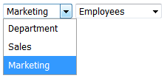

Slide 23
function GetEmp(D){
var SalesStaff = new Array('Bob Smith','Mark Jones', 'Sue Roger');
var MarketingStaff = new Array('Amber Thomas','Joanne Johnson','Sandy Russell');
for(i=1;i<=document.Form1.Employees.options.length-1;i++) {
document.Form1.Employees.options.remove(i);
}
Dept = D.options[D.selectedIndex].value;
if(Dept != "“) {
if(Dept == '1‘) {
for(i=1;i<=SalesStaff.length;i++) {
document.Form1.Employees.options[i] = new Option(SalesStaff[i-1]);
} }
if(Dept == '2') {
for(i=1;i<=MarketingStaff.length;i++) {
document.Form1.Employees.options[i] = new Option(MarketingStaff[i-1]);
} } } }

Slide 24
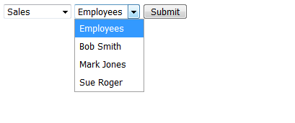
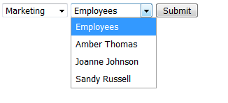

Slide 25
Validating Menu Selection
Problem with Menu – User doesn’t select an item from Menu before submitting the form.
This could cause the problem
Problem can be solved by Javascript to determine whether the required menu option is selected or not before submitting the form.
<form onsubmit=“return ValidateForm()” action = “Form2.html”>

Slide 26
<body>
<form onsubmit="return ValidateForm(this)" name="Form1" action="Form2.html">
<select name="Candidate">
<option value=""> Vote For president</option>
<option value="0"> Amber Thomas</option>
<option value="1"> Joanne Admas</option>
<option value="2"> Sandhy Rogers</option>
<option value="3"> Sue Smith</option>
<option value="4"> Tom Paine</option>
<input type = "submit" value="Submit" />
</form>

Slide 27
function ValidateForm(ValForm)
{
v = ValForm.Candidate.selectedIndex;
if(ValForm.Candidate.options[v].value == "")
{
alert("select option");
return false;
}
return true;
}

Slide 28
Creating DHTML Menus
Floating Menu
Chain Select Menu
Tab Menu
Popup Menu
Highlighted Menu
Folding Tree Menu
Context Menu
Scrollable Menu
Side Bar Menu
Side In Menu

Slide 29
Floating Menu
floating menus stay in a fixed position when you scroll the page. They appear to "float" on top of the page as you scroll.
The effect is achieved with by moving <div> container that containing menu.
The style is applied on<div> container where position, width, height, background and z-index property is specified.
An element with greater position is always placed in front of another element with lower z-index.

Slide 30
<body onload="document.Form1.DeptList.selectedIndex=0">
<div style = "position:fixed; width:200px; height:50px; top:10px; right:10px; background:#33FFFF; z-index:100">
Floating Menu.
<form name="Form1">
<select name="DeptList" >
<option value="0">Department</option>
<option value="1">Sales</option>
<option value="2">Marketing</option>
</select>
</form>
</div>
….
……
</body>

Slide 31
Chain Select Menu
Similar to the Dynamically Changing Menu

Slide 33
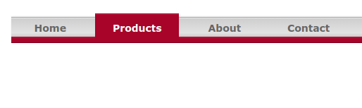
Tab Menu
Tab menu display a one or two word description of the menu option within a tab.
A more complete description is displayed below the tab bar as visitor moves mouse cursor over the tab.

Slide 34
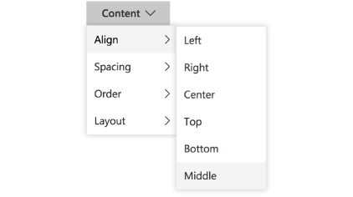
Pop up Menu
A pop up menu displays several parent menu items
A menu appears as the visitors moves the cursor over a parent menu item. The pop up menu contains child menu items that are associated with parent menu item
An item in menu can be activated either onmouseover or onclick event.

Slide 35
Slide-In Menu
The slide-in menu appears as a vertical block that floats on the left side of the webpage.
It seems to come alive when visitor moves the mouse cursor over the block.
The block pulls to the right , dragging along with it the hidden menu, when mouse cursor moves on to the block.
The hidden menu can contain menu names and options.
E.g. https://freefrontend.com/css-sliding-menus/

Slide 36
Highlighted Menu
Example - http://www.dynamicdrive.com/dynamicindex1/highlightmenu2.htm
We can highlight menu items by following two ways:
When visitor perform onmouseover() event over menu item, the browser dispays a box around the item with shadow at the bottom of the box
When the visitor perform onclick() event on the menu item, the highlight shadow appears at the top of the box rather than at the bottom of the box.

Slide 37
Folding tree menu
It is like a classic Menu used in desktop applications
The tree consist of one or more closed folders.
The tree expands when the visitor clicks on the closed folder, showing one or more menu options associated with it.
The tree collapse when the visitor clicks on the open folder.
Example –
http://www.dynamicdrive.com/dynamicindex1/navigate1.htm

Slide 38
Context Menu
Context menu pops up on the web page when the visitor clicks the right mouse button.
The location of context menu on the screen is determined by the position of the mouse cursor.
The mouse cursor sets the position of upper-left corner of the context menu.
Each menu item is automatically highlighted as visitors scrolls through the menu by moving mouse cursor.
The context menu is hidden from screen by clicking the mouse cursor away from the menu.
Example - http://www.dynamicdrive.com/dynamicindex1/contextmenu.htm

Slide 39
Scrollable Menu
If the space is limited and you want to show many menu items to present to visitors to your website you can use scrollable menu.
The scrollable menu displays limited number of menu items across the webpage.
Two arrowheads appear at both ends of visible list of menu items.
Visitors can simply move the mouse cursor over one of arrowheads and browser automatically scrolls the menu in the direction of arrow head.
Example - http://www.dynamicdrive.com/dynamicindex1/scrollerlink.htm

Slide 40
Sidebar Menu
As the name implies the side bar menu display a menu on the side of the webpage.
The visitor can click to menu by moving the mouse cursor over the menu item.
The menu that is associated with that item pops onto the screen.
Moving the cursor away from the menu item closes the popup menu and sidebar menu remains on the screen.
Example - http://www.dynamicdrive.com/dynamicindex1/hvmenu/index.htm

Slide 41
Protecting Webpage
There is nothing secret about your webpage.
Anyone with little computer knowledge can use a few mouse clicks to display your HTML code, including your Javascript on the screen.
Although you cannot entirely prevent intruders to view our webpage, but can take a few steps to stop all but the best computer wizards from gaining access to your javascript.

Slide 42
Different ways to protect webpage
Hiding your Source Code
Concealing E-Mail Address

Slide 43
Hiding your Source Code
Every developer has to admit that, on occasion, they have peeked at the code of webpage by using right-clicking on the webpage and choosing “View Source” option from the context menu.
There are 2 ways to hide your source code:
Disabling the right click mouse button
Hiding Javascript

Slide 44
Hiding Source Code – Disabling Right Click
Define the function(BreakInDetected) in the Javascript that is called every time the visitor clicks the right mouse button.
Define functions for different browsers e.g. Internet Explorer or Netscape Navigator.
In these functions check which mouse button visitor clicked.
Functions definition has to check whether any button except first button is clicked.

Slide 45
Hiding Source Code – Disabling Right Click
document.layers property is used to check the browser
Document.layer = null // Internet Explorer
Document.layer = not null // Netscape Navigator
<script>
function BreakInDetected()
{alert(“Security Violations”); return false;}

Slide 46
function NetscapeBrowser(e)
{
If(e.which == 2 || e.which == 3)
{
BreakInDetected(); return false;
}
}

Slide 47
function InternetExplorerBrowser()
{
If((event.button == 2)|| (event.button == 3))
{
BreakInDetected(); return false;
}
}

Slide 48
If(document.layers){
Document.captureEvents(Event.MOUSEDOWN);
Document.mousedown = NetscapeBrowser();
}
Else if (document.all && !document.getElementById)
{
Document.onmousedown = InternetExploreBrowser();
}
Document.oncontextmenu = new Function(“BreakInDetected(); return false;);

Slide 49
Hiding Source Code – Hiding Script
You can hide your Javascript from visitor by storing it in an external file on your web server.
External file should have .js extension.
<script src=“Myscript.js”>
You need to define empty function for each function that you define in the external Javascript file.
Function OpenBook (book) { }
Create the external Javascript file. Place all function definition in the file and saving file with .js extension on the web server.

Slide 50
Webserver
Client Side Browser
Myscript.js
Function OpenBook(book)
{
If(book ==1){
document.cover.src=“img1.jpg”
Mywin = window.open(‘’,’myw’,height=500,width=50,left=500,top=400);
Mywin.document.write(“10% discount”);
<script src=“Myscript.js”>
function OpenBook (book) { }
</script>

Slide 51
Concealing Email Address
We all receive spam mail in our inbox and think that such mails are sent by merchants.
But our email address are captured by SpamCrawler and Spam Bots.
Some Spammer creates program called as bots that surf Net looking for email address that are embedded into web pages.
The bots strip these email address on the webpage and store them for use in spam attack.

Slide 52
To avoid this solution is to conceal email address in the source code so that bots can’t find it but still the email address appear on the webpage.
Bots identify email address
By mailto: attribute
And by @ sign
To avoid the bots from getting email address is by generating them dynamically in the java script.
Within Javascript also you need to conceal the email address.

Slide 53
To conceal the email address
Create a strings that contains part of email address.
Built Javascript that assemble those strings into into email address which is then written to web page.

Slide 54
Example
Create 4 Strings
First string contains the addressee and domain along with symbols &,* and _ to confuse the bot
Var x = ‘BobSmith&smith*c_o_m’ //BobSmith@smith.com
The second and third string contains portion of the mailto: attribute name
Var y = ‘mai’
Var z = ‘lto’
The fourth string contain subject line
Var s = ‘?subject=Customer Enquiry’
Then use replace method of string to replace & with @ and * with (.)
The underscore replaced with nothing.
All strings are concatenated and then assign to location attribute of the window object.
mailto:BobSmith@smith.com?subject=Customer Enquiry

Slide 55
<script>
Function CreateEmailAddress()
{
Var x = ‘BobSmith&smith*c_o_m’
Var y = ‘mai’
var z = ‘lto’
Var s = ‘?subject=Customer Enquiry’
X = x.replace (‘&’,’@’) // BobSmith@smith*c_o_m
X = x.replace(‘*’,’.’) // BobSmith@smith.c_o_m
X = x.replace(‘_’,’’) // BobSmith@smith.co_m
X = x.replace(‘_’,’’) // BobSmith@smith.com
Var b = y + z + ‘:’+ x + s // mailto: BobSmith@smith.com
Window.location = b;
}
</script>
<body>
<input type= button value=“Help” onclick=“CreateEmailAddress()”>
</body>

Slide 56
Window Status Bar
Status bar is message bar at the bottom of window
To display message on the status bar you need to assign the message to the status property of the window object.
Syntax –
window.status
Example –
Win = Window.open(‘’,mywin,’’status=1,width=500,height=500,left=50,top=50’);
Win.status = “Hello”;
Alert(win.status);

Slide 57
Changing the message using rollover
We can change the contents of the status bar on any event.
Example
<script>
Win = window.open(‘’,’mywin’,’status=1,width=500,height=500,left=50,top=50’);
Win.status = “Hello”;
Win.document.write(‘<input type=“button” name=“but” value=“clcik me” onmouseover=“Win.status=\‘h1\’; ” />’);
</script>

Slide 58
Moving Message along the status bar
<script>
Win = Window.open(‘’,mywin,’’status=1,width=500,height=500,left=50,top=50’);
Var msg = “text is moving”;
Var place =1;
function Scroll()
{
Win.status = msg.substring(0,place);
If(place >= msg.length )
Place = 1;
Else
Place++;
Window.setTimeout(“Scroll()”,50);
}
</script>
<body onload=“scroll()”>
</body>

Slide 59
Identifying the Browser
navigator object contains information about the browser
Property | Description
appCodeName | Returns the code name of the browser
appName | Returns the name of the browser The returned value varies from different browsers: IE11, Firefox, Chrome and Safari returns "Netscape" IE 10 and earlier versions return "Microsoft Internet Explorer" Opera returns "Opera"
appVersion | Returns the version information of the browser
cookieEnabled | Determines whether cookies are enabled in the browser
language | Returns the language of the browser
userAgent | Returns the user-agent header sent by the browser to the server

Slide 60
<script>
var txt = "";
txt += "<p>Browser CodeName: " + navigator.appCodeName + "</p>";
txt += "<p>Browser Name: " + navigator.appName + "</p>";
txt += "<p>Browser Version: " + navigator.appVersion + "</p>";
txt += "<p>Cookies Enabled: " + navigator.cookieEnabled + "</p>";
txt += "<p>Browser Language: " + navigator.language + "</p>";
txt += "<p>Browser Online: " + navigator.onLine + "</p>";
txt += "<p>Platform: " + navigator.platform + "</p>";
txt += "<p>User-agent header: " + navigator.userAgent + "</p>";
Alert (txt);
</script>

Slide 61
Framework of Javascript and It’s Application
Think of building websites and web apps like building a house—when you set out to build a house, you could create all of your own building materials from scratch and start building without any schematics, but that approach would be incredibly time-consuming and doesn’t make a lot of sense. It’s more likely that you would purchase pre-manufactured building materials (wood, bricks, countertops, etc.) and then assemble them based on a blueprint to fit your specific needs.

Slide 62
Framework of Javascript and It’s Application
A software framework is an abstraction in which software providing generic functionality can be selectively changed by additional user-written code.
JavaScript framework is an application framework written in JavaScript where the programmers can manipulate the functions and use them for their convenience.

Slide 63
At their most basic, JS frameworks are collections of JavaScript code libraries that provide developers with pre-written JS code to use for routine programming features and tasks

Slide 64
AngularJS
AngularJS is a client side JavaScript MVC framework to develop a dynamic web application.
AngularJS was originally started as a project in Google but now, it is open source framework.
AngularJS is entirely based on HTML and JavaScript, so there is no need to learn another syntax or language.
AngularJS is also called just "Angular".
AngularJS changes static HTML to dynamic HTML. It extends the ability of HTML by adding built-in attributes and components and also provides an ability to create custom attributes using simple JavaScript.

Slide 65
AngularJS Advantages
Advantages of AngularJS
Open source JavaScript MVC framework.
Supported by Google
No need to learn another scripting language. It's just pure JavaScript and HTML.
Supports separation of concerns by using MVC design pattern.
Built-in attributes (directives) makes HTML dynamic.
Easy to extend and customize.
Supports Single Page Application.
Uses Dependency Injection.
Easy to Unit test.

Slide 66
ReactJS
React is a JavaScript library created for building fast and interactive user interfaces for web and mobile applications.
It is an open-source, component-based, front-end library responsible only for the application’s view layer.
In Model View Controller (MVC) architecture, the view layer is responsible for how the app looks and feels.
React was created by Jordan Walke, a software engineer at Facebook.
Instagram webpage example, entirely built using React.
React divides the UI into multiple components, which makes the code easier to debug.

Slide 67
ReactJS Advantages
Easy creation of dynamic
Improved performance
Reusable components
Unidirectional data flow
React is easy to learn
It can be used for the development of both web and mobile apps
Dedicated tools for easy debugging

Slide 68
NodeJS
Node.js is an open-source, Javascript runtime environment on Chrome’s V8 that lets you effortlessly develop fast and scalable web applications.
It utilizes an event-driven, non-blocking I/O model that makes it lightweight, efficient and excellent for data-intensive real-time applications that run across shared devices.
Node.js can be used to build different types of applications such as command line application, web application, real-time chat application, REST API server etc.
However, it is mainly used to build network programs like web servers, similar to PHP, Java, or ASP.NET.
Node.js was written and introduced by Ryan Dahl in 2009.

Slide 69
NodeJS Advantages
Node.js is an open-source framework under MIT license. (MIT license is a free software license originating at the Massachusetts Institute of Technology (MIT).)
Uses JavaScript to build entire server side application.
Lightweight framework that includes bare minimum modules. Other modules can be included as per the need of an application.
Asynchronous by default. So it performs faster than other frameworks.
Cross-platform framework that runs on Windows, MAC or Linux

Slide 70
MeteorJS
Meteor is a free, open-source JavaScript framework written using NodeJS.
It allows rapid prototyping and produces cross-platform code. It’s gaining popularity in the market with over 13,000 websites using Meteor.
Websites like mtv.com, meteofrance.com and so on make use of Meteor to build their UI.

Slide 71
MeterorJS Advanatages
Full stack: Meteor offers a full-stack solution for developing and deploying web applications. Meteor comes bundled with several built-in features, such as reactive templates, automatic CSS, etc.
Smart packages: Building a login system for your application can be burdensome. But not with Meteor. Meteor packages make it easy to add features such as user accounts, JavaScript libraries like React and more. The best part is, adding these kinds of smart packages is easy, just a few keystrokes in the terminal and you have it.
Real-time web apps: Meteor is the perfect solution for those looking to build real-time applications. All of the application’s layers from database to template update automatically. This means there is no need to refresh the page to see updates. And any changes to documents save instantly. This makes Meteor a perfect use-case for real-time collaboration.
Single language development: Meteor allows using the same code on the front-end and the back-end as well, for mobile and web applications. It prevents developers from requiring to install and configure different libraries, module managers, APIs, drivers and more. This saves a lot of production time of developers as they do not need to perform context switching between server language and JavaScript.

Slide 72
BackboneJS
BackboneJS is a lightweight JavaScript library that allows to develop and structure the client-side applications that run in a web browser. Unlike other frameworks, Backbone puts the developer in charge of choosing the right tool that works best for a given project. Currently, over half a million websites are making use of Backbone, this includes tumblr.com, espn.com, soundcloud.com and many more.

Slide 73
BackboneJS Features
Separated business and UI logic: The single most important thing that Backbone can help you with, is keeping your business logic separate from your user interface. When the two are entangled, change is hard. But when logic doesn’t depend on UI, your interface becomes easier to work with.
Event-driven communication: When a project grows, the jQuery declarations and callbacks gets more complex. The code becomes more cluttered. Backbone.js overcomes this problem by providing an event-driven communication between views and models.
Less code: Conventions are a great way to introduce a common coding style without the need of coming up with an extensive set of coding standards. The more you stick to backbone conventions the less you have to code, and in turn, the code becomes more standardized and readable.
Syncing with backend: All thanks to its excellent support for RESTful APIs, the models in BackboneJS can be easily tied to a back-end. If the API is designed correctly, backbone is already configured to access these directly for read, write, and delete operations.

